Slide 1
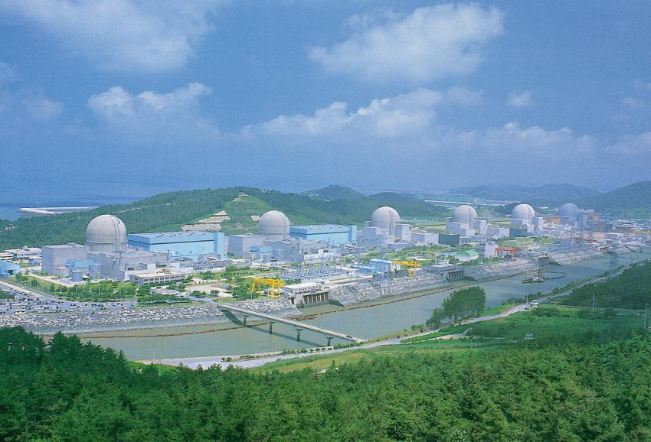
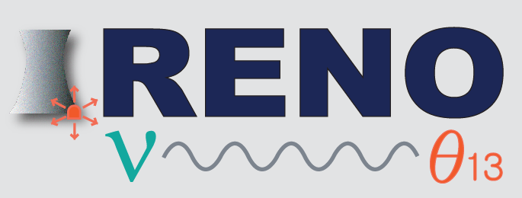
Status of RENO Experiment
Reactor Neutrino Oscillation in Korea
Sapporo Winter School, Hokkaido University
March 8-10, 2012
Kim Siyeon 金始衍
Chung-Ang University 中央大

Slide 2
Outline
Experimental Goal
- Systematic & Statistical Uncertainties
- Expected θ₁₃ Sensitivity
Overview of the RENO Experiment
- Experimental Setup
- YongGwang Power Plant
- Detector Construction (completed in Feb. 2011)
RENO Data-Taking and Analysis (start from Aug. 2011)
- Status
- Energy Calibration
- Reduction

Slide 3
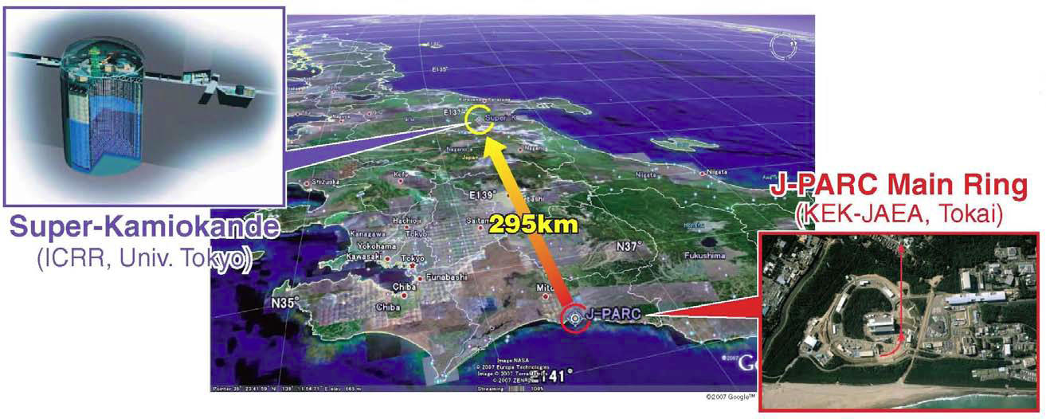

Recent Experimental Hints on sin²(2θ₁₃)
* Observed number of ν_{e} candidate events : 6
* Expected number of events (sin²(2θ₁₃) =0) : 1.5±0.3
(2.5σ significant excess
→ 0.03 < sin²(2θ₁₃) < 0.28 with normal hierarchy at 90% C.L. )
* PRL 107, 041801 (2011) : “Indication of Electron Neutrino Appearance from an Accelerator-produced Off-axis Muon Neutrino Beam”
[MINOS : June 24, 2011, Observed 62 against 49, 0.0 < sin²(2θ₁₃) < 0.12 ]

Slide 4
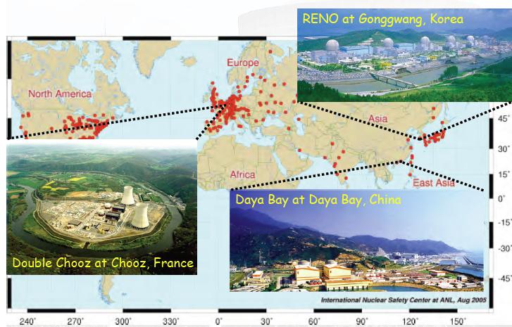
Reactor θ₁₃ Experiments
The first results
from DC and DB
Double Chooz
@ LowNu 2011, Nov. 9, 2011 ;
sin²(2θ₁₃) = 0.085
+/- 0.029 (stat.)
+/- 0.042 (syst.)
@ 68% CL
Daya Bay March 8, 2012 ;
Data of 55 days, 10416 electron anti neutrinos
R = observed / expected
= 0.940 +/- 0.011 (stat.) +/- 0.004 (syst.) @ 5.2 sigma
sin²(2θ₁₃) = 0.092 +/- 0.016 (stat.) +/- 0.005 (syst.) @ 5.2 sigma

Slide 5
Goal of RENO Experiment
CHOOZ : R_{osc} = 1.01 ± 2.8% (stat) ± 2.7% (syst)
sin²(2θ₁₃) < 0.17 (90% C.L.)
RENO : sin²(2θ₁₃) > 0.02 (for 90% C.L.)
sin²(2θ₁₃) > 0.035 (for 3σ discovery potential)
statistical error : 2.8% → 0.3%
systematic error : 2.7% → <0.5%
Larger statistics
- More powerful reactors (multi-core)
- Larger detection volume
- Longer exposure
→ Obtain <1% precision !!!
Smaller experimental errors
- Identical multi detectors
Lower background
- Improved detector design
- Increased overburden
RENO Proposal, hep-ex/1003.1391 (2010. 03)

Slide 6
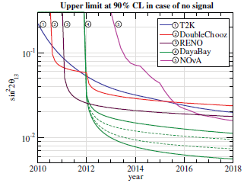
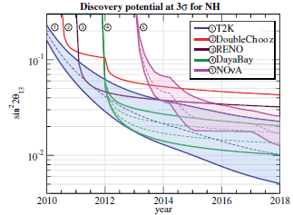
Prospect for θ₁₃
Mezzetto & Schwetz, J. Phys. G (2010) 103001

Slide 7
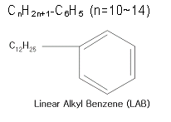

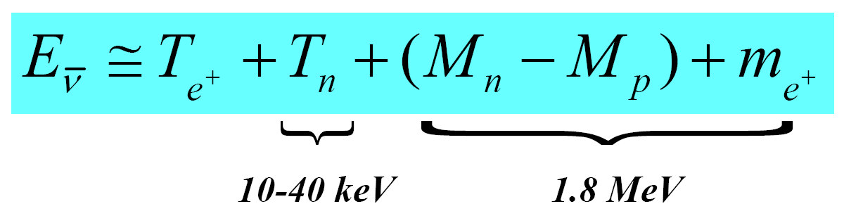
Detection of Reactor Antineutrinos
(prompt signal)
~180 μs
(delayed signal)
+ p → D + γ (2.2 MeV)
~30 μs
+ Gd → Gd + γ‘s (8 MeV)
Neutrino energy measurement

Slide 8
Expected Number of Neutrino Events at RENO
2.73 GW per reactor ⅹ 6 reactors
1.21x10³⁰ free protons per target (16 tons)
Near : ~ 800/day, 300,000/year
Far : ~ 85/day, 31,000/year
3 years of data taking with 70% efficiency
Near : 9.83x10⁵ ≈ 10⁶ (0.1% error)
Far : 8.74x10⁴ ≈ 10⁵ (0.3% error)

Slide 9

Reduction of Systematic Uncertainties
Detector related :
- “Identical” near and far detectors
- Careful calibration
Reactor related :
- Relative measurements with near and far detectors
Neutrino flux
1/r²
Number of protons
Detection efficiency
Yield of sin²(2θ₁₃)

Slide 10
Experimental Method of θ₁₃ Measurement
ν_{e}
ν_{e}
Oscillations observed as a deficit of anti-neutrinos
ν_{e}
ν_{e}
ν_{e}
the position of the minimum is defined by Δm²₁₃ (~Δm²₂₃)
ν_{e}
1.0
sin²2θ₁₃
flux before oscillation observed here
Probabilité ν_{e}
Distance
1200 to 1800 meters
Find disappearance of ν_{e} fluxes due to neutrino oscillation as a function of energy using multiple, identical detectors to reduce the systematic errors in 1% level.

Slide 11
Expected Systematic Uncertainty
Systematic Source |  | CHOOZ (%) | RENO (%)
Reactor related absolute normalization | Reactor antineutrino flux and cross section | 1.9 | < 0.1
 | Reactor power | 0.7 | 0.2
 | Energy released per fission | 0.6 | < 0.1
Number of protons in target | H/C ratio | 0.8 | 0.2
 | Target mass | 0.3 | < 0.1
Detector Efficiency | Positron energy | 0.8 | 0.1
 | Positron geode distance | 0.1 | 0.0
 | Neutron capture (H/Gd ratio) | 1.0 | < 0.1
 | Capture energy containment | 0.4 | 0.1
 | Neutron geode distance | 0.1 | 0.0
 | Neutron delay | 0.4 | 0.1
 | Positron-neutron distance | 0.3 | 0.0
 | Neutron multiplicity | 0.5 | 0.05
combined |  | 2.7 | < 0.5

Slide 12
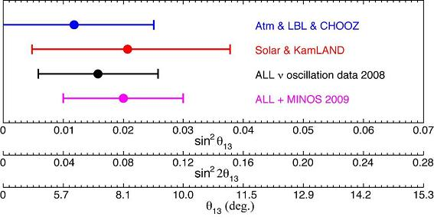
RENO Expected Sensivity
90% CL Limits
Discovery Potential” (3σ)
sin²(2θ₁₃) > 0.035
sin²(2θ₁₃) > 0.02
RENO
Chooz
10 times better sensitivity than the current limit
G. Fogli et al. (2009)

Slide 13
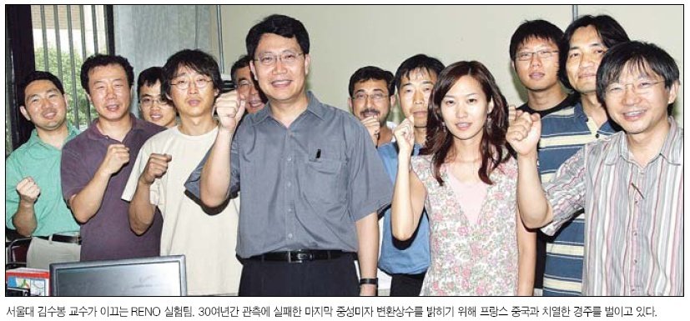
RENO Collaboration
(13 institutions and 40 physicists)
Chonnam National University
Chonbuk National University
Chung-Ang University
Dongshin University
Gyeongsang National University
Kyungpook National University
Pusan National University
Sejong University
Seoyoung University
Seokyeong University
Seoul National University
Sungkyunkwan University
California State University Dominguez Hills (USA)

Slide 14
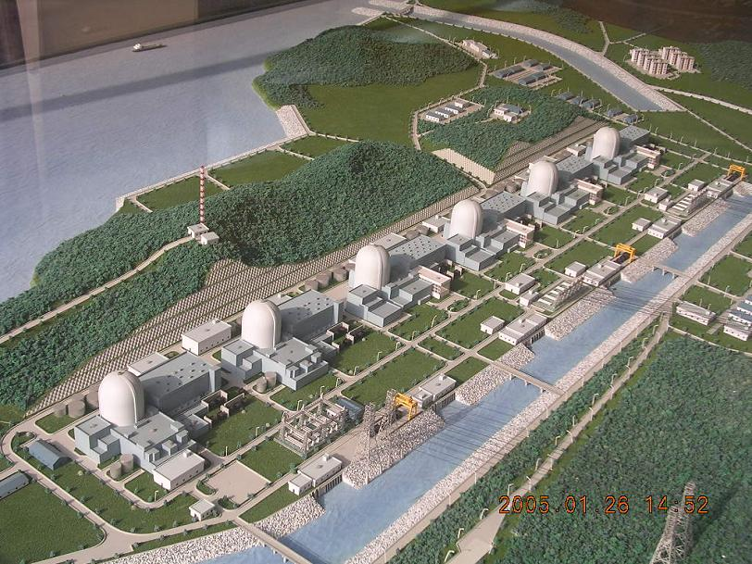
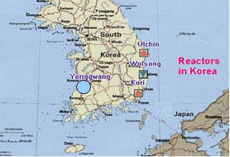
Comparison of Reactor Neutrino Experiments
Experiments | Location | Thermal Power (GW) | Distances Near/Far (m) | Depth Near/Far (mwe) | Target Mass (tons) | sin²(2θ₁₃) 90% C.L.
Double-CHOOZ | France | 8.7 | 410/1050 | 115/300 | 8/8 | 0.03
RENO | Korea | 17.3 | 290/1380 | 120/450 | 16/16 | 0.02
Daya Bay | China | 17.4 | 360(500)/1985(1613) | 260/910 | 40X2/80 | 0.01
YongGwang (靈光) :

Slide 15
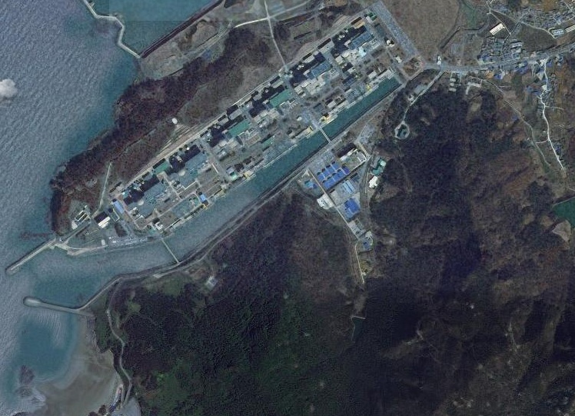

Google Satellite View of Experimental Site
Near Detector
290m
1380m
Far Detector

Slide 16
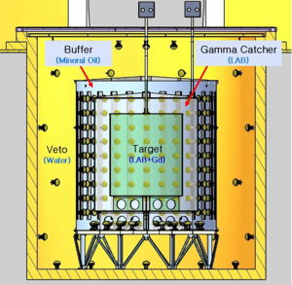
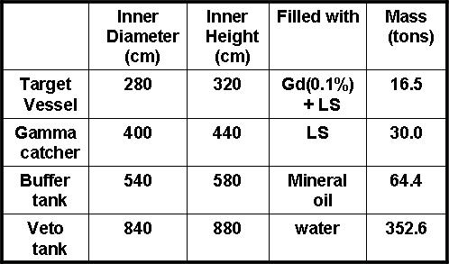
RENO Detector
354 10” Inner PMTs :
14% surface coverage
67 10” Outer PMTs

Slide 17
Summary of Detector Construction
2006. 03 : Start of the RENO project
2008. 06 ~ 2009. 03 : Civil construction including tunnel excavation
2008. 12 ~ 2009. 11 : Detector structure & buffer steel tanks
completed
2010. 06 : Acrylic containers installed
2010. 06 ~ 2010. 12 : PMT test & installation
2011. 01 : Detector closing/ Electronics hut & control room built
2011. 02 : Installation of DAQ electronics and HV & cabling
2011. 03 ~ 06 : Dry run & DAQ debugging
2011. 05 ~ 07 : Liquid scintillator production & filling
2011. 07 : Detector operation & commissioning
2011. 08 : Start data-taking

Slide 18
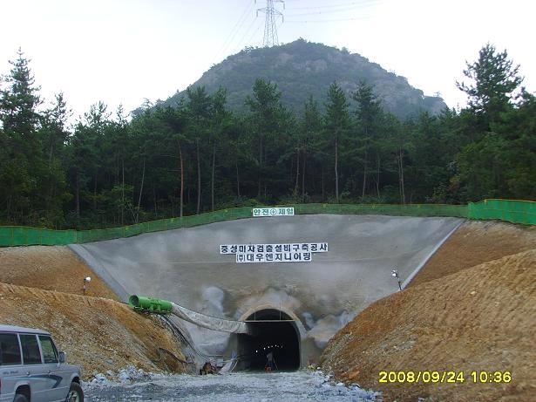
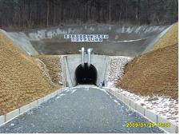
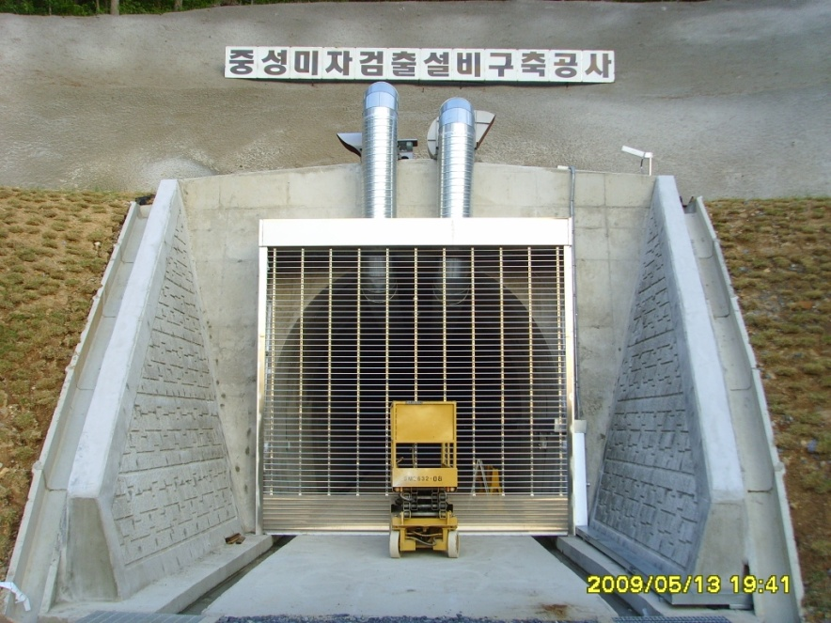
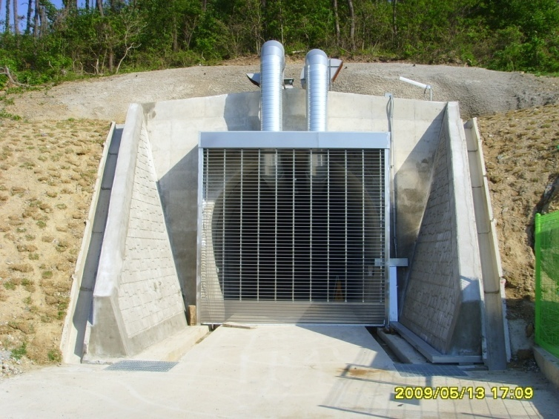
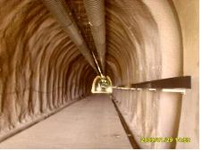
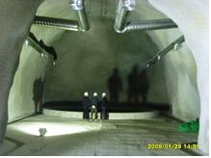
Construction of Near & Far Tunnels (2008. 6~2009. 3)
by Daewoo Eng. Co. Korea
Far site
Near site

Slide 19
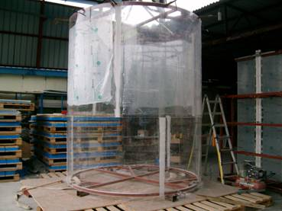
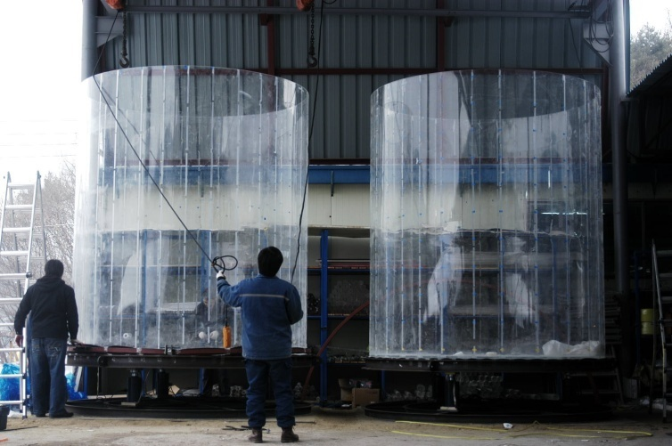
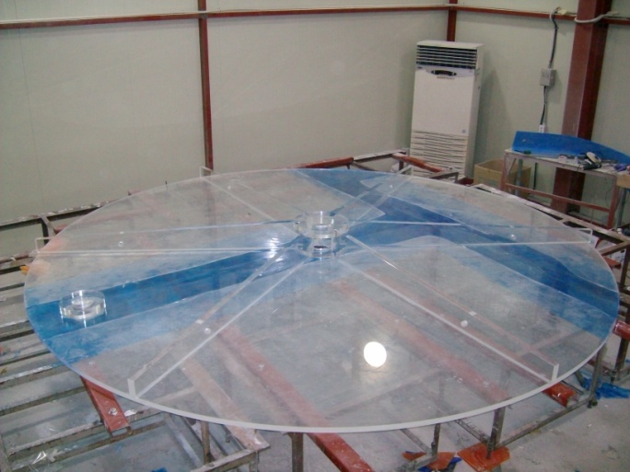
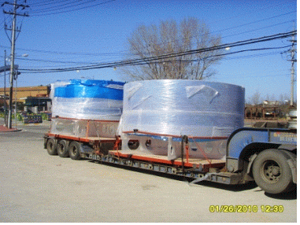
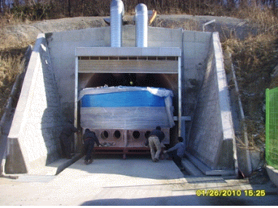
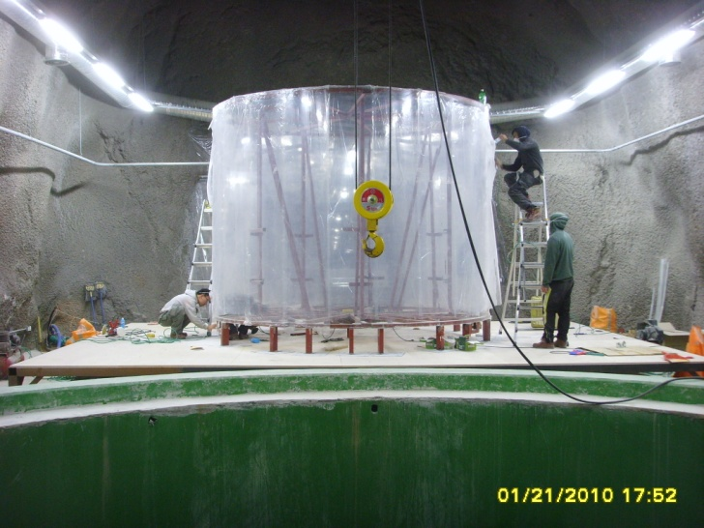
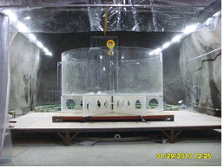
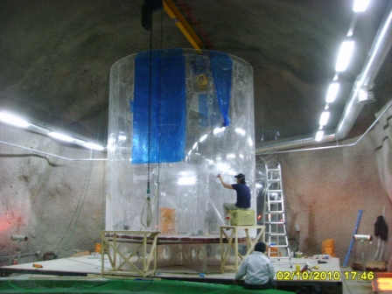
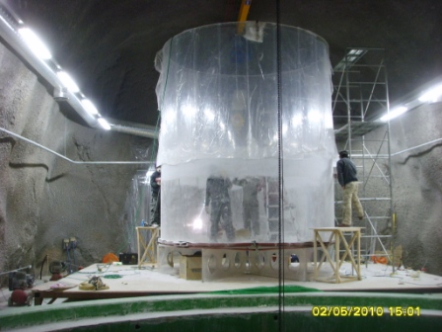

Slide 20
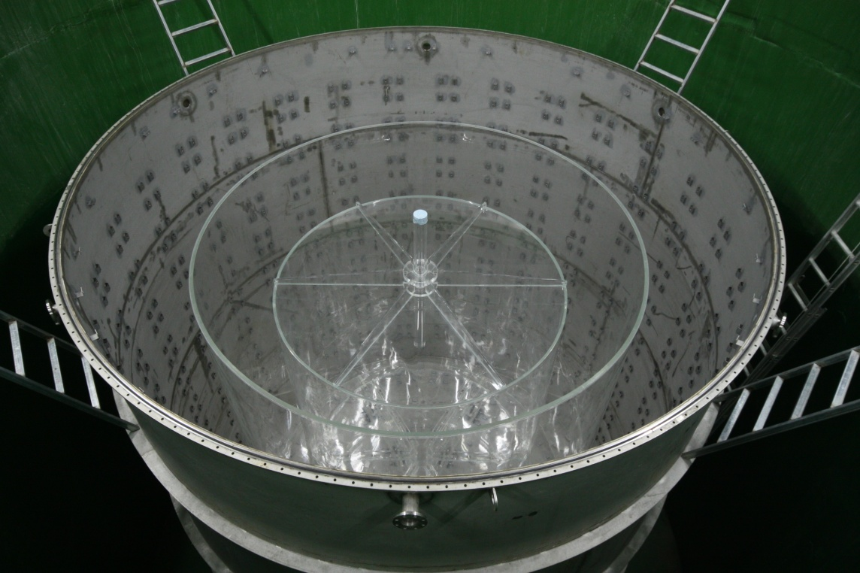
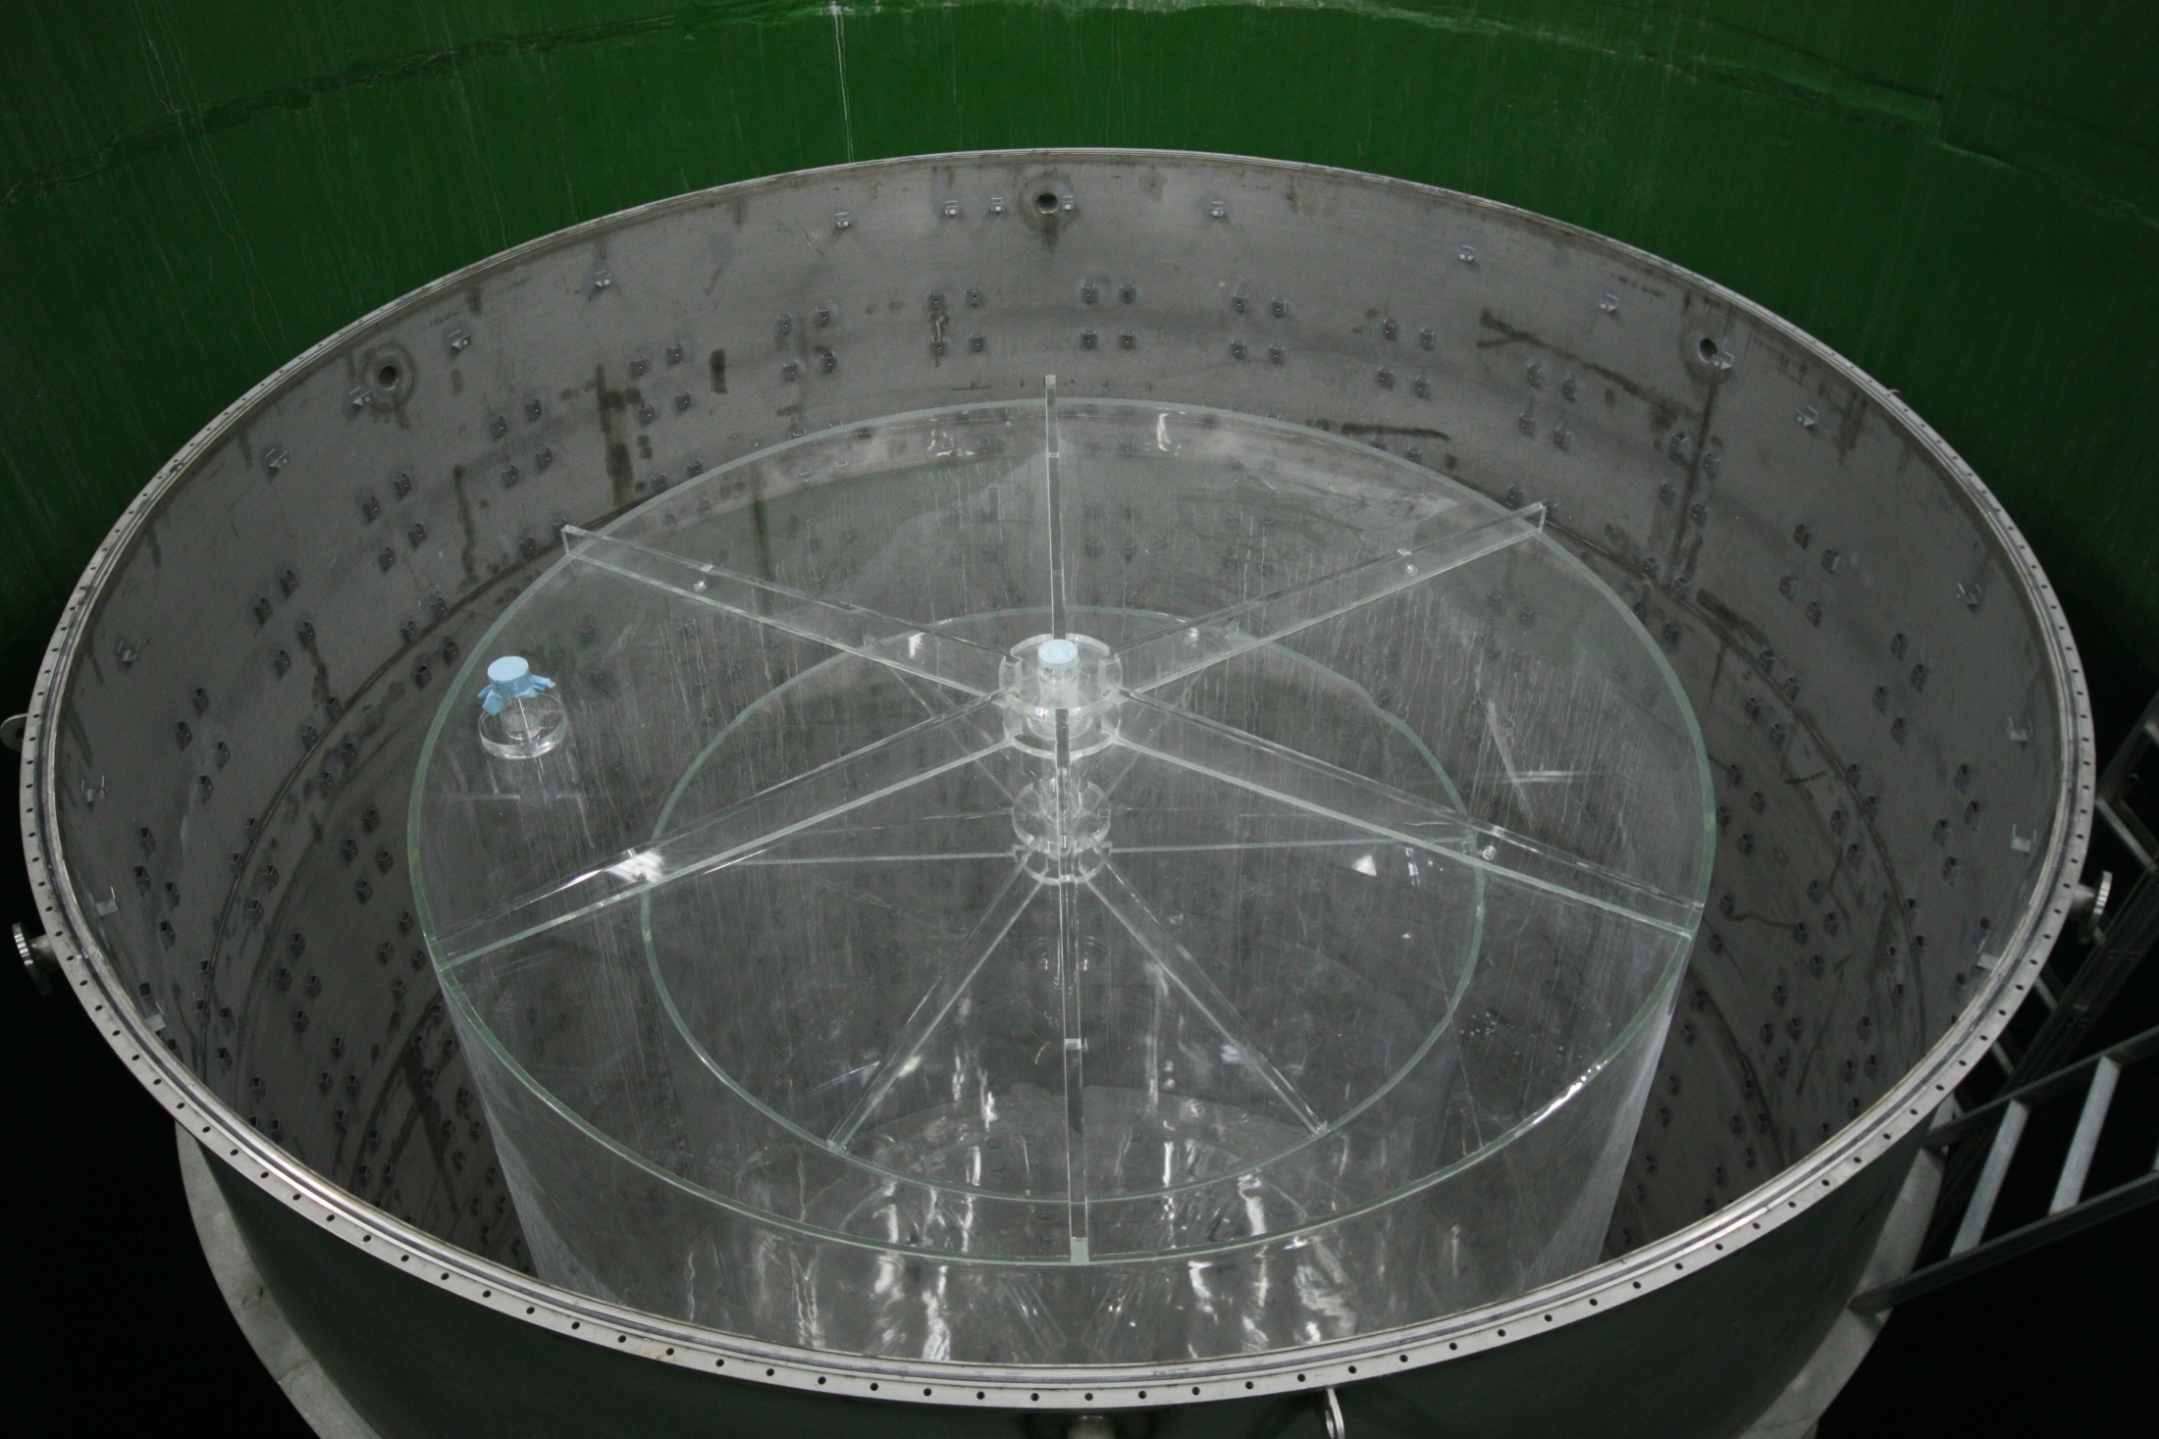
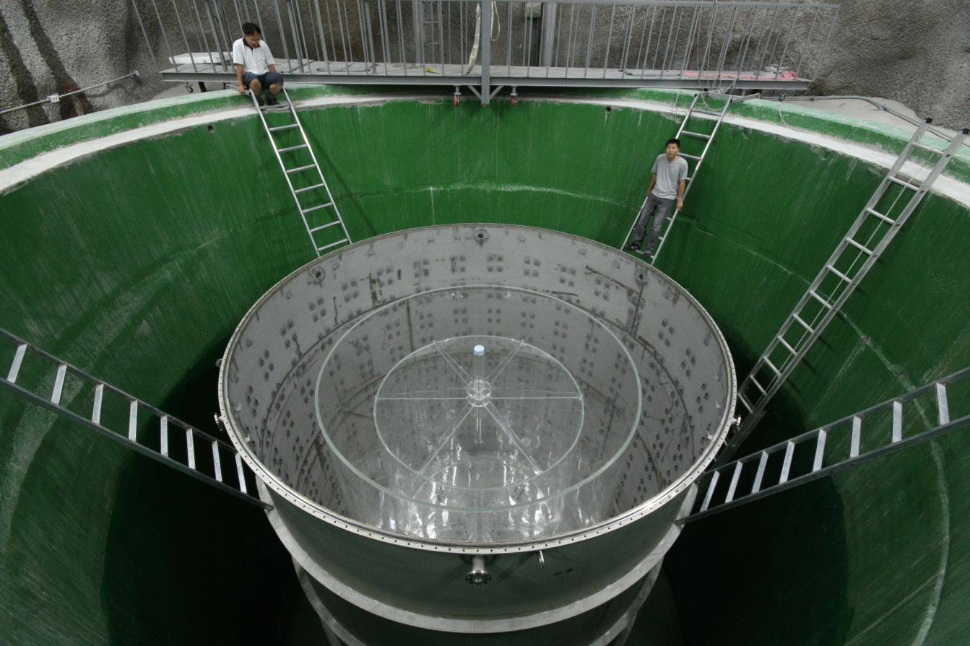
Installation of Acrylic Vessels (2010. 6)

Slide 21
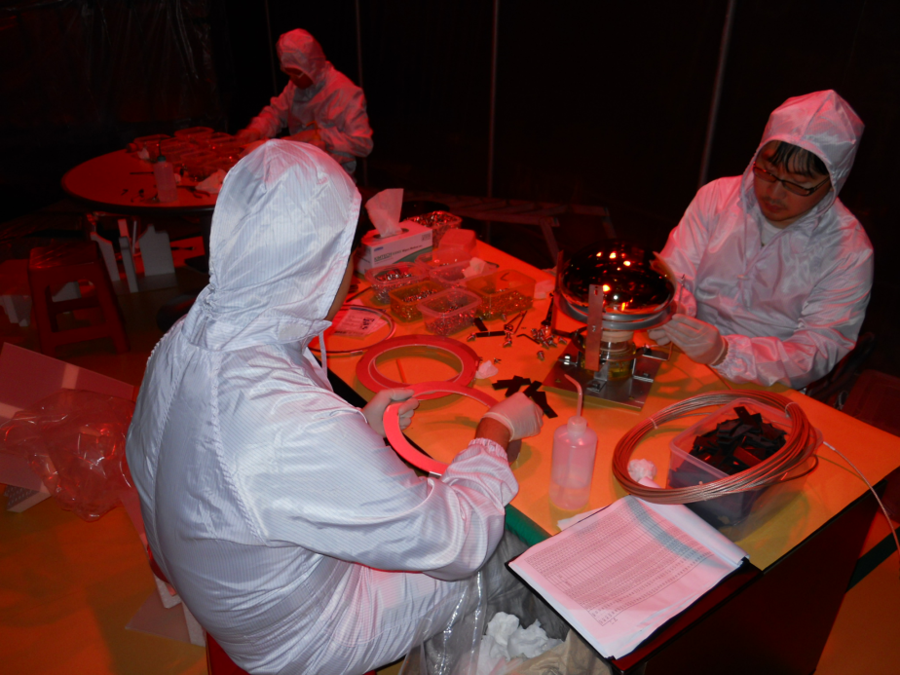
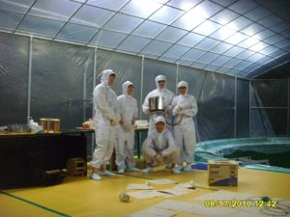
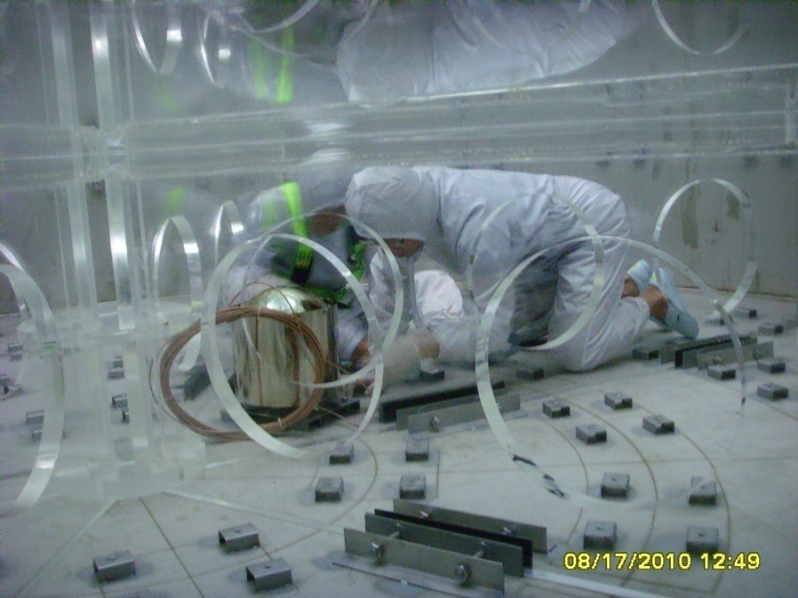
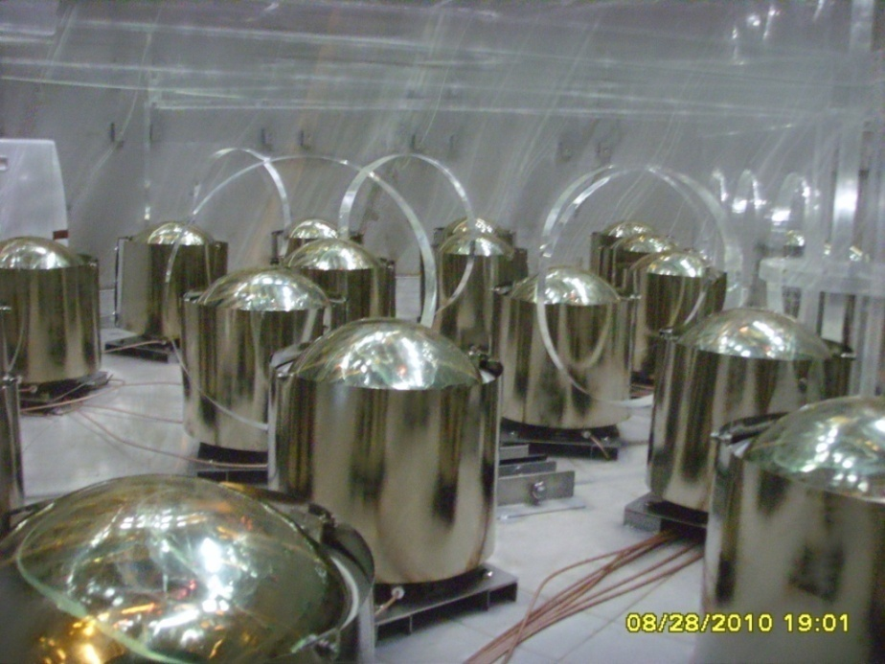
PMT Mounting (2010. 8~10)

Slide 22
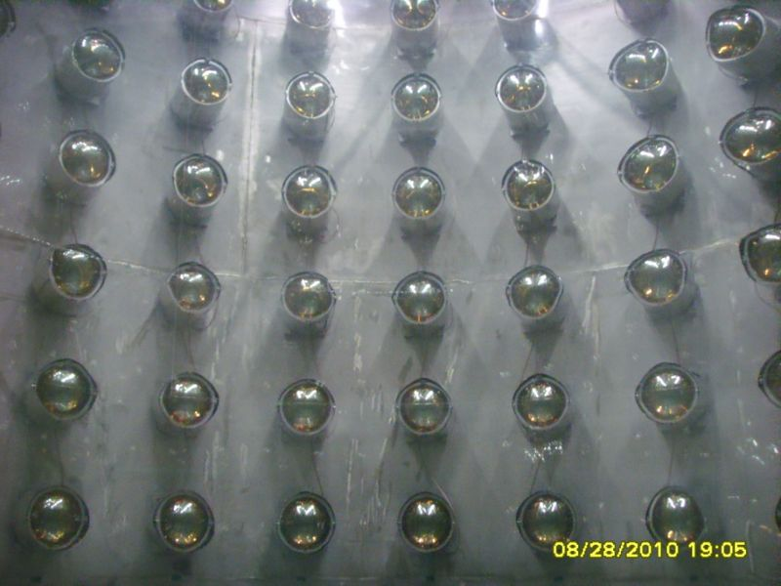
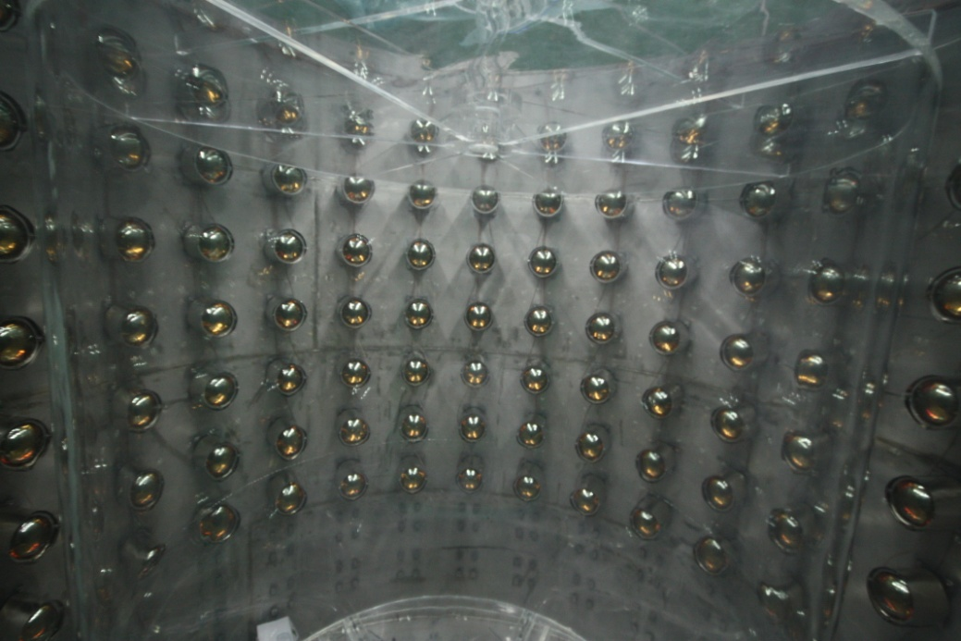
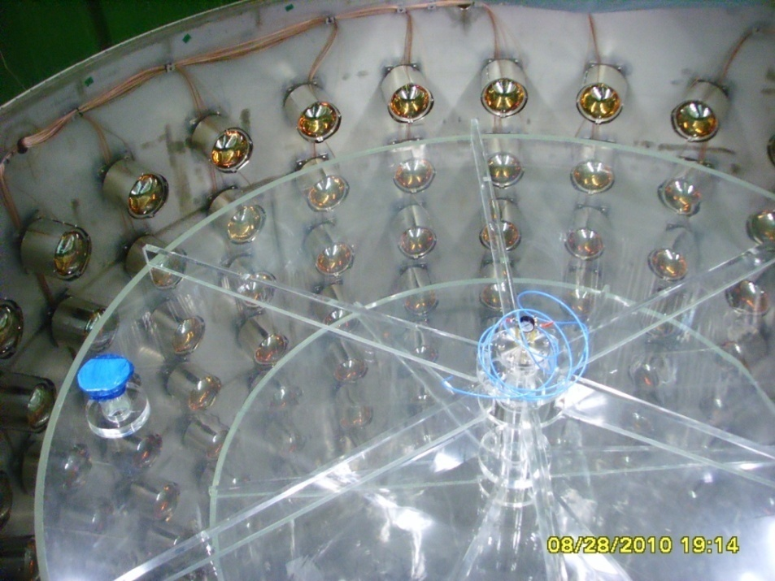
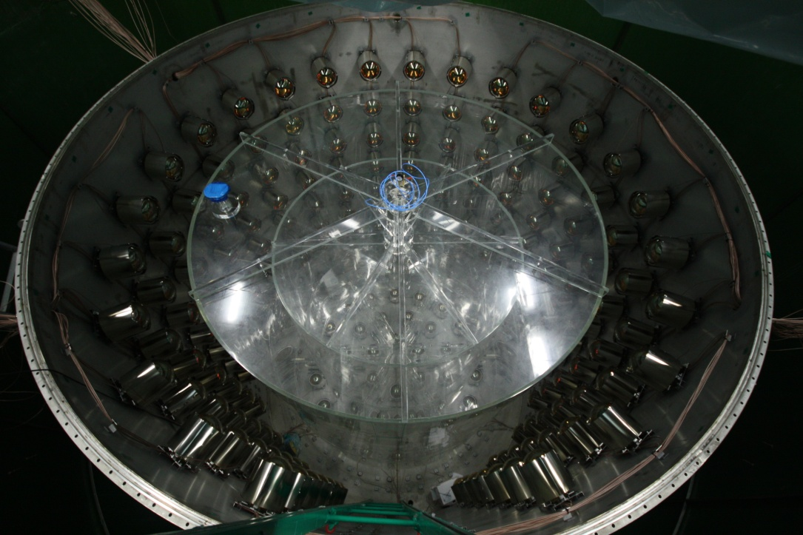
PMT Mounting (2010. 8~10)

Slide 23
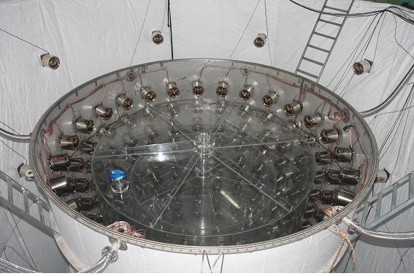
Finishing PMT installation (2011. 1)
VETO (Water)
Buffer(Mineral Oil)
Gamma Catcher (LS)
Neutrino Target
(Gd+LS)

Slide 24
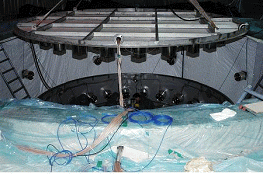
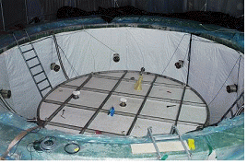
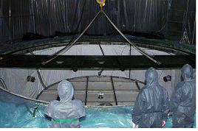
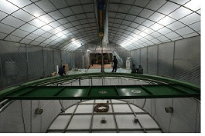
Detector Closing (2011. 1)

Slide 25
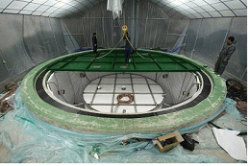
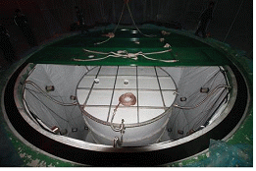
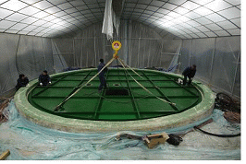
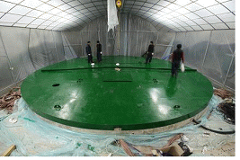
Detector Closing (2011. 1)
Near : Jan. 21, 2011
Far : Jan. 24, 2011

Slide 26




Electronics Hut & Control Room Installed (2011. 1)

Slide 27






PMT Cable Connection to DAQ Electronics (2011. 2)

Slide 28

Dry Runs (2011. 3 ~ 5)
Electronics threshold : 1mV based on PMT test with a bottle of liquid scintillator and a Cs source at center
discri. thr.
-0.4mV
-0.5mV
-0.6mV
-0.7mV
-1.0mV
Charge(counts)

Slide 29



Gd Loaded Liquid Scintillator
C_{n}H_{2n+1}-C₆H₅ (n=10~14)
Recipe of Liquid Scintillator
Aromatic Solvent & Flour | WLS | Gd-compound
LAB | PPO + Bis-MSB | 0.1% Gd+TMHA (trimethylhexanoic acid)
High Light Yield : not likely Mineral oil(MO)
replace MO and even Pseudocume(PC)
Good transparency (better than PC)
High Flash point : 147ºC (PC : 48ºC)
Environment friendly (PC : toxic)
Well-known component(MO : not well known)
Domestically available: Isu Chemical Ltd.
0.1% Gd compounds with CBX (Carboxylic acids; R-COOH)
- CBX : TMHA (trimethylhexanoic acid)

Slide 30




Liquid Production System (2010. 11~2011. 3 )

Slide 31



Liquid Filling (2011.6)
LS filling for Gamma Catcher
Gd-LS filling for Target
Gd Loaded Liquid Scintillator
Both near and far detectors are filled with Gd-LS, LS & mineral oil as of July 5, 2011.
Veto water filling was completed at the end of July, 2011.
Water filling for Veto

Slide 32


PMT Gain Matching
PMT gain : set 1.0x10⁷ using a Cs source at center
Gain variation among PMTs : 3% for both detectors.
Gain (10⁷)

Slide 33

RENO Electronics
QBEE
(QTC Based Electronics w/ Ethernet)
24 channel input
60MHz clock
0.1pC, 0.52nsec resolution
~2500pC/ch large dynamic range
No dead time (w/o hardware trigger)
Fast data transfer via Ethernet R/W
Software Trigger
Software trigger selects the events specified by using the timing information
in each hit-data cell
17usec
Periodic Trigger
time
Event# (N-1)
Event# N
Event# (N+1)

Slide 34

Run Control and DAQ Monitoring
Real time event rate

Slide 35



Slow Control & Monitoring System
HV monitoring system
Environmental monitor
Online event display
& histograms

Slide 36


RENO Event Display
Neutron candidate captured by Gd
Accidental background sample

Slide 37
Trigger Rate
Near and Far detectors are identical.
* Main Detector Event : Event triggered by more than 90 inner PMTs within 50nsec (corresponding to 0.5~0.6MeV)
** Veto Event : Event triggered by more than 10 veto PMTs within 50nsec
 | NEAR | FAR
Depth | 120 mwe | 450 mwe
Distance from Reactor | 290 m | 1380 m
*Main Detector Event | ~300 Hz | ~100 Hz
** Veto Event | ~500 Hz | ~60 Hz

Slide 38


Efficiency of Data Taking
 | NEAR | FAR
Start of Physics Run | 19th Aug. 2011 | 11th Aug. 2011
Integrated days | 165.5days | 188.5days
Efficiency in total | 94.0% | 97.7%

Slide 39

Data Storage Resource
( Super Computer Center )
( RENO Site )

Slide 40


Calibration System
1D, 3D source driving system at
the center of TARGET
1D source driving system at one
side of GAMMA CATCHER
Laser Injectors at 5 positions in
Buffer Tank

Slide 41




Calibration with Radio Sources
Cs
Ge
Near Detector
Far Detector
Co
Cf

Slide 42


Calibration with Radio Sources
Near Detector
Far Detector
Cf
Cf
Co
Co
Cf
Cf
Ge
Ge
Cs
Cs
Energy distributions in two detectors are well-calibrated.

Slide 43

Reduction for Neutrino Event Selection
Basically, events triggered by veto PMTs are excluded.
  Removal of background:
  Exclude high energy cosmic ray
  events ( and events which include
  several veto hits).
  Exclude external gamma-ray events
  ( sorted by event patterns using
  Qmax/Qtot).
  Exclude Michel electron events
  and fast neutrons induced by muons.
Selection of reactor neutrino events:
Coincidence window of the prompt signals and delayed signals
3 MeV
7.8 MeV

Slide 44


Background Events
Neutrons induced by cosmic muons
Capture Time
2.2 MeV (Captured by H)
7.8 MeV (Captured by Gd)
(p.e.)

Slide 45

Neutron Events Induced by Cosmic Muon
- Captured by H -
Capture Time
Near Detector
Far Detector
[ Capture Time Vs. Date ]

Slide 46


Reactor Neutrino Candidates at ND
Energy dist. of prompt signal
Energy dist. of delayed signal

Slide 47

Reactor Neutrino Candidates
Energy Distribution of Delayed Signals
Near Detector
Far Detector

Slide 48

Stability in Energy Distribution of Delayed Signals
Reactor Neutrino Candidates
Near Detector
Far Detector
[ Energy of delayed signals Vs. Date ]

Slide 49


Capture Time of Delayed Neutrons
Near Detector
Far Detector
Tau =27.8 +/- 0.2usec
Tau =27.6 +/- 0.4usec
Gd concentration of RENO detector was measured ~ 0.11%

Slide 50

Time Interval b/w Prompt and Delayed
Time interval between
Prompt Signal and Delayed Signal
at Near Detector
* One point is 1week data.

Slide 51
Neutrino Flux from each reactor
Reactor # | Far ( % ) | Near (% )
1 | 14.23 | 7.06
2 | 16.31 | 15.54
3 | 17.82 | 33.80
4 | 18.28 | 26.71
5 | 17.53 | 11.37
6 | 15.83 | 5.52
We measured the baseline within 10 cm error and estimated the ratio of neutrino flux from each reactor. The error propagation to the number of events is less than 0.1%

Slide 52

Reactor Neutrino Candidates at ND
804
687
14.6% decrease
@1 reactor off (Reactor# 2)

Slide 53
Summary
RENO has been taking data with near & far detectors since last August and its integrated efficiency of data taking is above 90% in both detectors.
Detectors are stable and well-calibrated, and data acquisition and analysis are going on smoothly.
Oscillation analysis with data of far detector is almost completed. RENO result coming up soon.

Slide 54

RENO’s six-month data can observe sin²(2θ₁₃) if it is larger than 0.05 at 3σ level .
RENO expects to release the first result in a couple of months and hope to present it in Neutrino 2012 @ Kyoto.

