Slide 1
Hourly climatological precipitation in July
Over the Gulf Stream, peaks occur from early morning.
Over land, peak is in late afternoon.
24hr clock for Local Solar Time
Gulf Stream

Slide 2
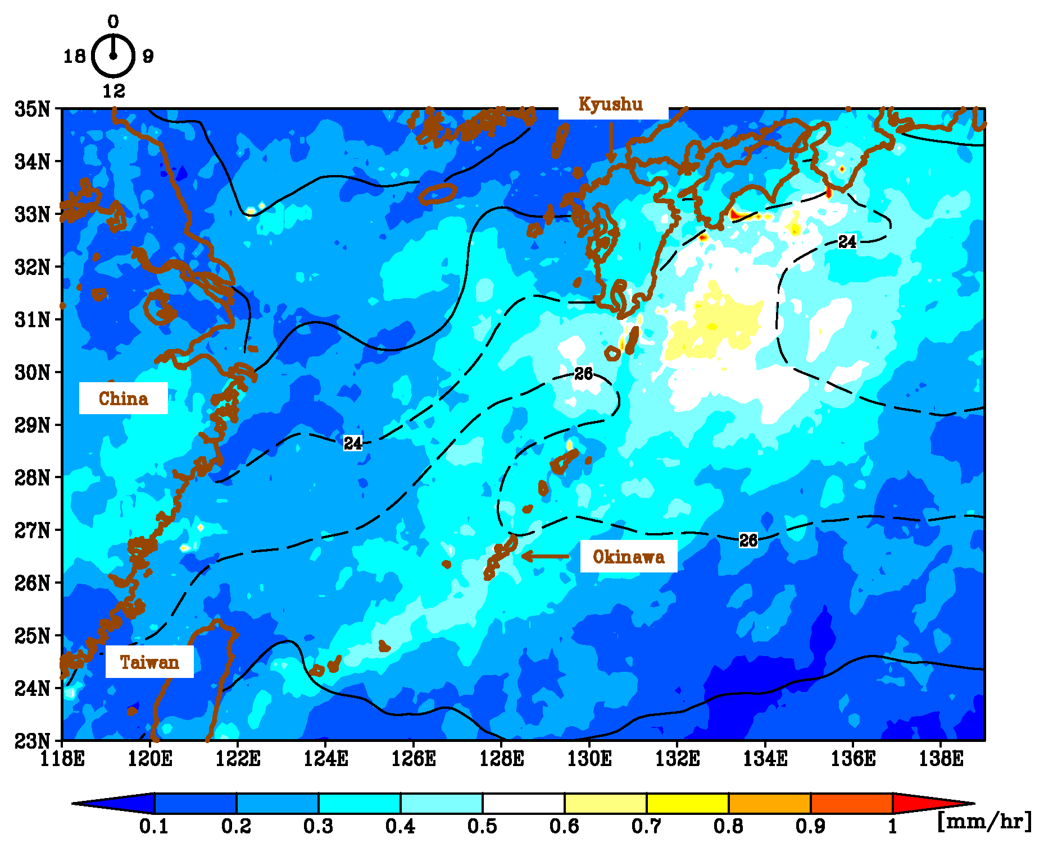
Hourly climatological precipitation in July
Precipitation maxima occurs in late morning (delayed to Gulf Stream maximum).
24hr clock for Local Solar Time
East China
Sea
Kuroshio
24C
←Okinawa
28C
East China
Sea

Slide 3
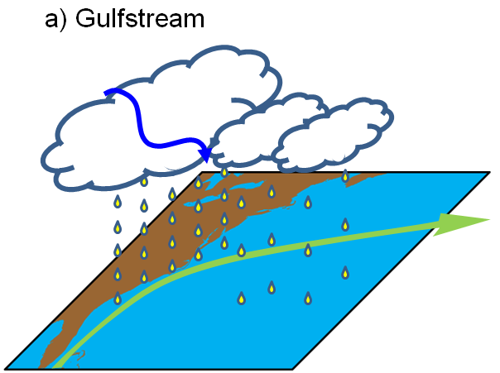
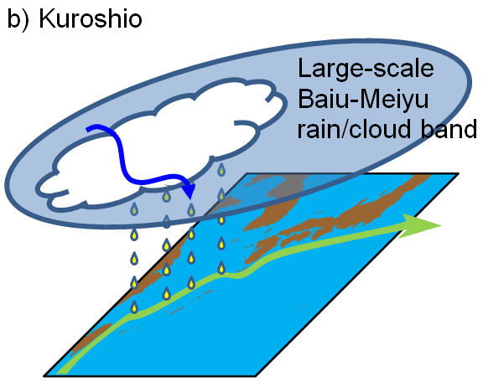
Schematics
Diurnal modulation of deep convections connects …
the ocean and the atmosphere,
and also weather and climate,
and provide new possibilities of studies for air-sea interaction over WBCs.
Important aspects of
Deep heating mode
Diurnal precipitations are not limited to the Gulf Stream, which gives stronger mean precipitations and thus diurnal amplitudes.
Diurnal precipitations are limited to the Kuroshio, and are embedded in large-scale Baiu-Meiyu rainband, which does not have strong diurnal cycles.

